Slide 1
Persona Template

Slide 2
© KickStart Alliance 2015
Notes:
Here’s a generic persona template.
You’ll want to modify it for your own purposes, but notice how it captures key information on a single slide:
Who they are
Where they work
Why they are a good target
There is no “one size fits all” template for the ideal persona. The persona you create for your company will be different from a persona created by another company in another industry. With that in mind, include only the information that is relevant for the product or service being promoted. For example, if you are selling office equipment to growing businesses, it would be pointless to ask the persona what kind of car they drive or how many kids they have. Remember that we are talking personas in a B2B environment. Include information that will help you understand the persona’s needs, expectations, and behaviors about the part of their world that is relevant to the product you want to sell them.
Again, the persona template for your company will be unique. So, choose the dimensions important and relevant for your business.

Slide 3
Persona Template – Part 1
Who they are:
Name/gender/age
Education
Title/responsibility
Role in the purchase process
Attitude
Reputation
Remember, this is only a guide. Customize the template with characteristics and other details
relevant to your specific business and target market.
Notes:
Now, return to your answer to Exercise #4. You’ve already defined the bull’s eye. Now bring it to life by illustrating a persona – someone who lives and breathes in your target segment.
Take a fresh sheet of paper and:
Expand the who, where and why characteristics of your bull’s eye and apply them to your ideal persona
Focus, prioritize and summarize using the persona template.

Slide 4
Persona Template – Part 2
Where they work
Ideal company profile
Remember, this is only a guide. Customize the template with characteristics and other details
relevant to your specific business and target market.
Notes:
Now, return to your answer to Exercise #4. You’ve already defined the bull’s eye. Now bring it to life by illustrating a persona – someone who lives and breathes in your target segment.
Take a fresh sheet of paper and:
Expand the who, where and why characteristics of your bull’s eye and apply them to your ideal persona
Focus, prioritize and summarize using the persona template.

Slide 5
Persona Template – Part 3
Why they are a good target:
Values
Fears
“Pet peeves”
Information sources
Remember, this is only a guide. Customize the template with characteristics and other details
relevant to your specific business and target market.
Notes:
Now, return to your answer to Exercise #4. You’ve already defined the bull’s eye. Now bring it to life by illustrating a persona – someone who lives and breathes in your target segment.
Take a fresh sheet of paper and:
Expand the who, where and why characteristics of your bull’s eye and apply them to your ideal persona
Focus, prioritize and summarize using the persona template.

Slide 6
Persona Template – Part 4
Now, create a short-hand description of your persona
And, find a photo of a person who illustrates those characteristics
And finally, summarize all four slides into a single slide that can be shared with your entire team
Don’t forget to share your persona with marketers and sales reps.

Slide 7
Persona Examples
Here are a few examples of personas created by real companies. Slides 5 and 6 highlight key words included in the persona that helped drive a clear and focused positioning statement and customer messaging.

Slide 8
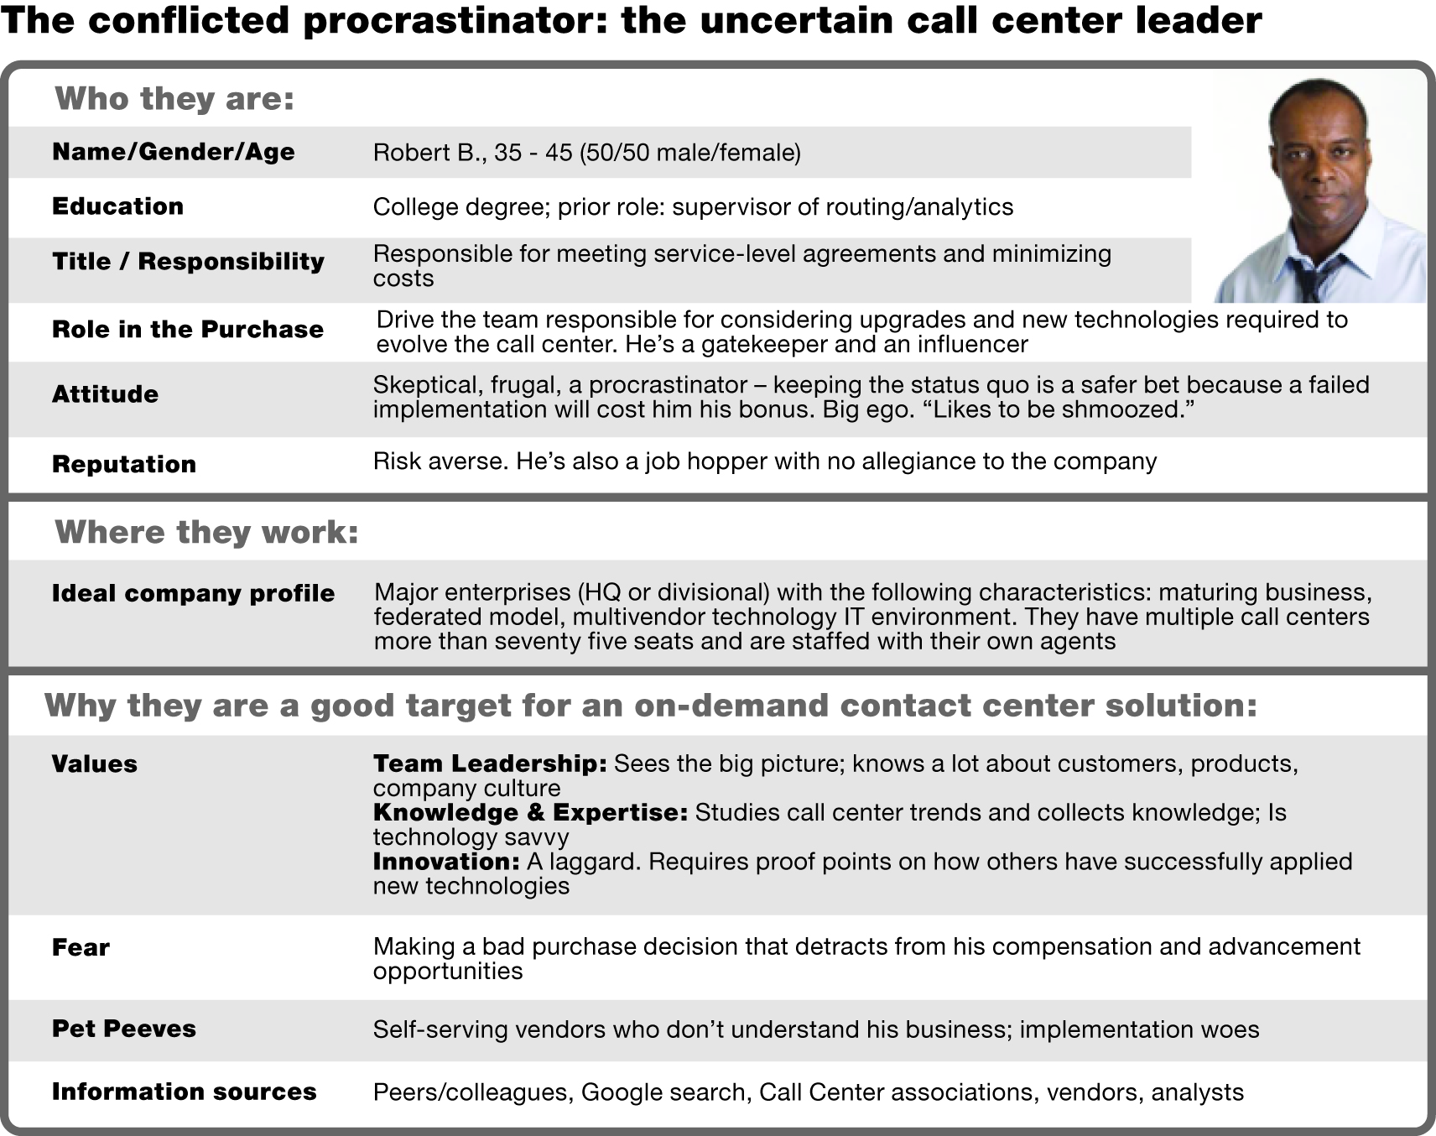
The “conflicted procrastinator” reflects the attitude of an executive who is afraid of making a bad purchase decision.
He is deliberate, slow to making a decision, and requires proof.
Notes:
The ideal persona for company #1 turned out to be Robert B, also known as “the conflicted procrastinator”.
Robert reflected the attitudes of an executive who is afraid of making a bad purchase decision.
He is deliberate, slow to making a decision, and he requires proof.
They also determined a set of values, fears, needs, and opportunities important to Robert. Robert reflects a market laggard.
Robert is clearly not “everybody.” But he was deemed to ideal “somebody” for company #1.

Slide 9
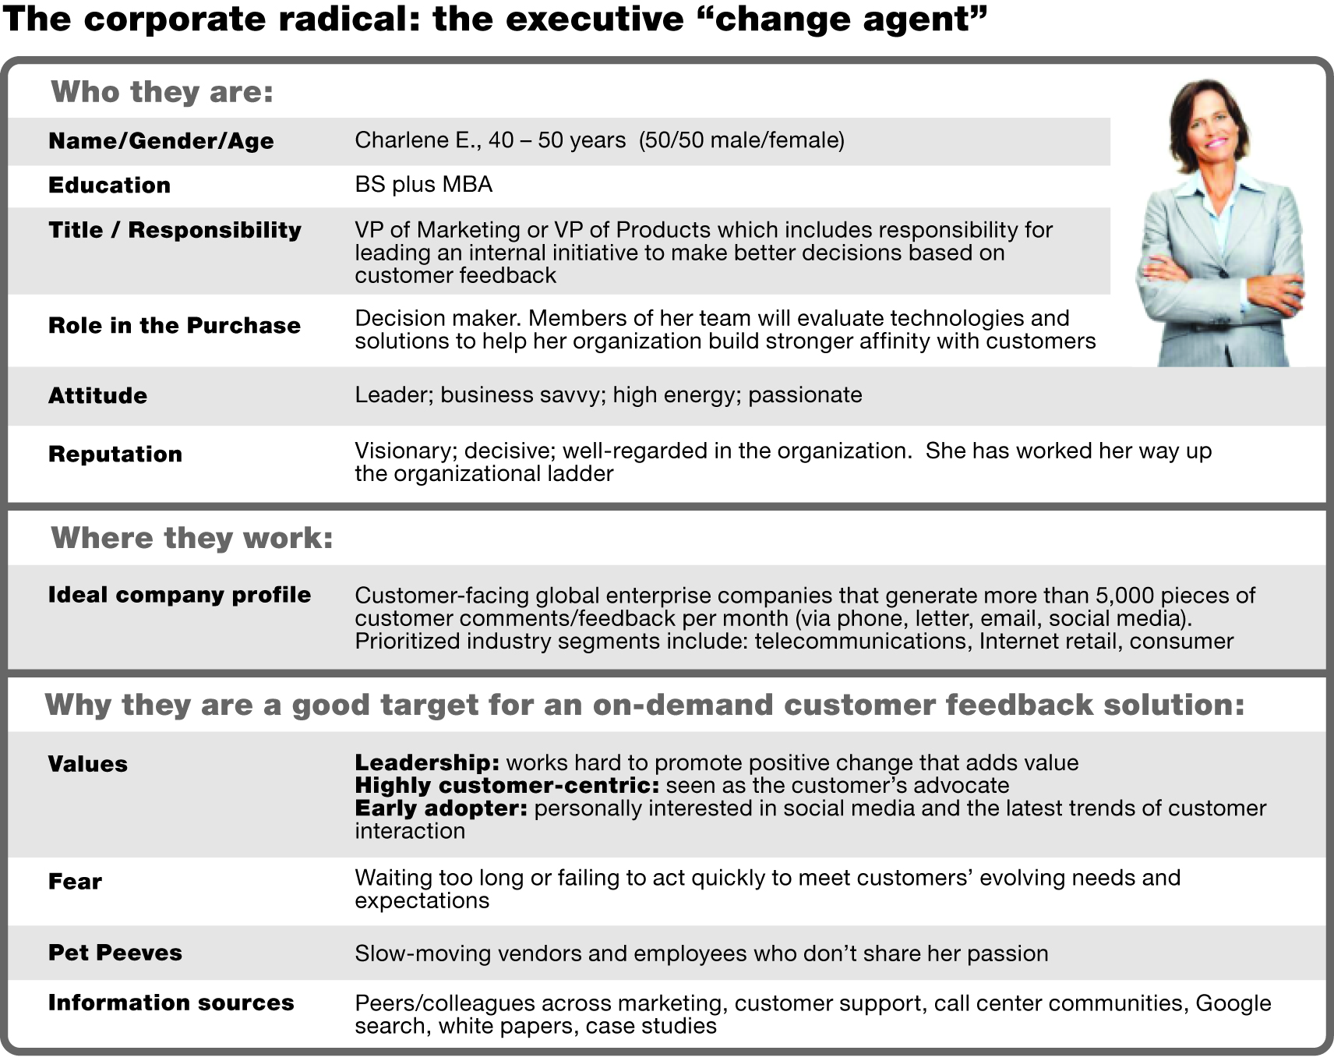
The “corporate radical” reflects an executive who yearns to be an “agent of change” in their company.
They tend to be early adopters.
They are not afraid to break away from the status quo.
Notes:
Charlene became the ideal persona for company #2.
Charlene represented the executive “change agent” – a corporate radical who yearns to be an agent of change in her company. She’s an early adopter. And she’s not afraid to break away from the status quo.
So, while Robert and Charlene represent two senior decision makers in technology companies, we can already see that how we approach and communicate with Robert and Charlene will be noticeably different.

Slide 10
The “globetrotter” persona hones in on travel-related concerns and priorities of the travelling executive.
Notice the implied differences between him and the occasional, non-business traveler.
Notes:
Company #3 build the persona of John – the globetrotter. He’s a frequent flyer business executive.
John represents a persona complete different from Robert and Charlene. This is because company #3 was interested in the travel requirements and expectations of senior executives who fly more than 100,000 per year.
We can immediately see that if company #3 spent money marketing to Robert and Charlene, that marketing investment would be wasted. Neither Robert and Charlene share the persona requirements of John. And that’s what company #3 is most interested in.

Slide 11
The “globetrotter” persona hones in on travel-related concerns and priorities of the travelling executive.
Notice the implied differences between him and the occasional, non-business traveler.
Notes:
Notice the items circled in red:
Always travelling
John has a reputation as “a road warrior”
He values high personal productivity while on the road
He hates travel fatigue and losing time if he comes sick while travelling
These are the clues.
Now, based on those clues, do you think you could build a marketing plan and story to engage John?
The persona brings these clues to light. Those clues now guide your marketing activities and offers and can influence product design.

Slide 12
Example of a user persona
The frustrated perfectionist: the supply chain systems user
Who they are:
Name/Gender/Age | Casey; 30 – 45 (50/50 male/female)
Education | Undergraduate, may have MBA
Title/Responsibility | Director or senior manager of supply chain, distribution or operations; responsible for managing relationships with supply chain vendors
Duties | Spends most of each day tracking shipments, negotiating contracts, and checking inventories
Attitude | Attention to detail
Reputation | Organized, efficient, but is a bit of a perfectionist (delivers quality results, but speed suffers)
Where they work:
Ideal company profile | Top brand, major retailer located in the US and/or Canada; carries thousands of different products; high volume retailer of clothing, food/beverage, or home furnishing products. The company’s computer system is antiquated; various computer systems are not integrated; pockets within the company still use Excel to track supplier movements
Why they are a good target for a new supply chain management product:
Values | High personal productivity; ability to multi-task; computer savvy; high integrity
Fear | Falling behind in their work because of of computer crashes, lost data, inability to stay current on daily shipment tracking
Pet Peeves | Spending too much time looking for data, doing data entry, manually connecting pieces of information from multiple systems
Personal goal | To win a promotion to VP, but that requires the ability to make better business decisions more quickly and to proactively find ways to save money and grow profits
Information sources | Retail business journals, peers, industry conferences, Google searches on next generation of supply chain management solutions
Notice the implied requirements for a new supply chain management system.
Notes:
Now let’s look at Casey, the frustrated perfectionist. Casey is a user – specifically, he’s a user of the supply chain system.
If you were a product manager for a company that manufactures a new supply chain management system, what clues from this persona might you find helpful?
Perhaps things like:
Casey spends a lot of time tracking shipments, negotiating contracts and checking inventory
He’s very attentive to detail
He is driven to produce high quality results, but he’s not fast. (We may infer that his managers may become frustrated with Casey because his perfectionist attitude causes him to fall behind.) * In fact, he hates falling behind.
What motivates Casey is a personal goal to win a promotion
He still uses Excel
So, what does any of this mean for developer of the next generation of supply chain management systems?

Slide 13
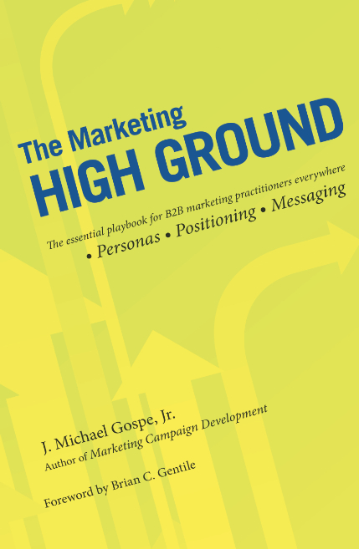
For more information on personas
Online course:
Product Management & Marketing: Personas
http://www.udemy.com/personas
Book:
The Marketing High Ground
http://tinyurl.com/hdufcq4

